Slide 1
Price Prediction for Mobile Phones
feature extraction analysis to identify the most influential features.

Slide 2
Introduction
In today's fiercely competitive mobile phone market, understanding the factors that drive pricing is crucial for businesses to stay ahead.
This project focuses on leveraging detailed information about mobile phone specifications to develop a predictive model for estimating mobile phone prices accurately.
The dataset encompasses a variety of features including model, colour, memory, RAM, battery capacity, camera specifications, presence of AI lens, mobile height, and processor, with price being the primary target variable.
We aim to uncover the key determinants influencing mobile phone prices. Through this analysis, our objective is to provide valuable insights that can inform pricing strategies and enhance decision-making processes in the dynamic landscape of the mobile phone industry.

Slide 3
Dataset overview
Our dataset comprises comprehensive information about various mobile phones, providing insights into the factors influencing their prices in today's competitive market. The key features included in the dataset are:
Model(specific model or brand), Colour(Indicates the colour variants), Memory( Denotes the storage capacity)RAM: Represents the Random Access Memory (RAM) capacity of the device, Battery Capacity(battery capacity in mAh).
Camera Specifications: Includes details about the rear and front camera specifications.
Presence of AI Lens: Indicates whether the mobile phone is equipped with an Artificial Intelligence (AI) lens for camera functionalities.
Mobile Height: Represents the physical height in millimetres (mm).
Processor: Specifies the processor or chipset used in the mobile phone for processing tasks.
Price: The target variable, representing the price of the mobile phone.

Slide 4
Project Tasks
Data Exploration
Data Pre-processing
Feature Extraction
Model Building
Model Evaluation
Feature Importance Analysis
Recommendation

Slide 5
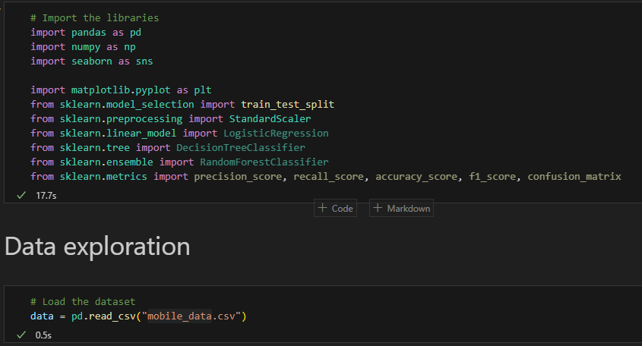
Important libraries, Load and exploration the data
Load the dataset data = Load the data using read.csv commend.
Data Exploration : We use the below commend.
print(data.head())
print(data.info())
print(data.describe())

Slide 6
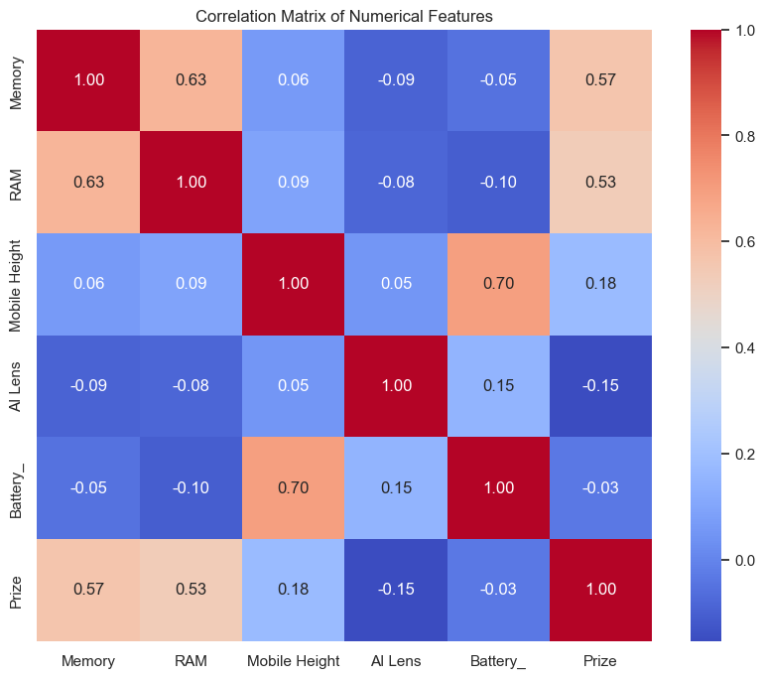
Correlation Matrix

Slide 7
Key Observations from Smartphone Features Correlation Matrix
Memory and Price: When smartphones have more internal storage, they usually cost more. So, as the memory increases, expect the price to go up too.
RAM and Price: Just like memory, if a phone has more RAM, it tends to be pricier. So, higher RAM often means a higher price tag.
Battery Capacity and Price: Surprisingly, having a bigger battery doesn't necessarily mean a much higher price for smartphones. The relationship between battery size and price isn't very strong.
Phone Height and Other Features: The height of a phone doesn't seem to have much impact on its memory, RAM, battery size, or price. So, how tall or short a phone is doesn't really affect these specs.
Memory and RAM: Phones with more internal storage often also have more RAM. So, it's common for high-end models to have both larger memory and RAM capacities.
AI Camera and Price: Having an AI camera feature doesn't seem to make a big difference in the price of smartphones. So, whether a phone has AI capabilities or not doesn't really affect its price

Slide 8
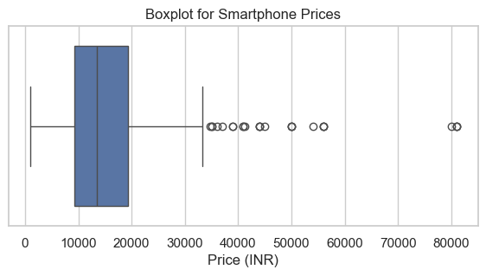
Plotting a box plot for the 'Prize' column to check for outliers

Slide 9
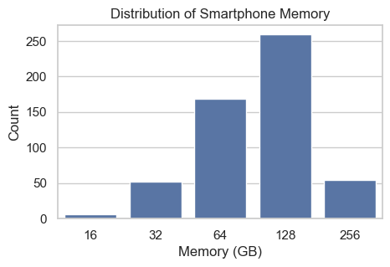
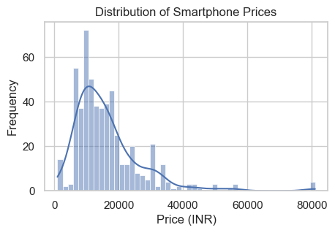
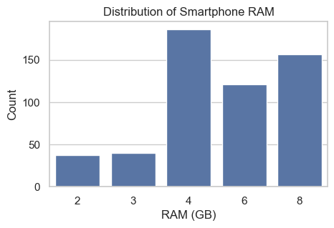
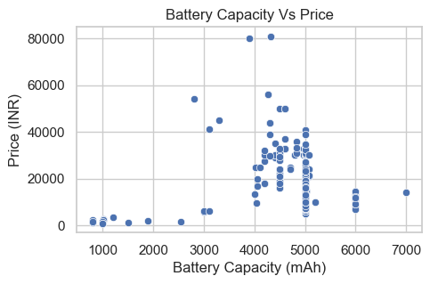
Some More Data Exploration By Visualization

Slide 10
Exploring Smartphone Data Through Visualization
Price Range: Most smartphones fall within the lower to mid price range, with fewer in the higher price range. This indicates a trend towards more affordable models.
Memory Sizes: 128 GB and 64 GB are the most common memory sizes, suggesting a preference for moderate to high storage capacity.
RAM Distribution: Many smartphones have 4 GB and 8 GB RAM, followed by 6 GB, while fewer have 2 GB and 3 GB RAM.
Battery Capacity vs. Price: The scatter plot of battery capacity against price doesn't show a strong linear relationship. This means battery capacity isn't a major factor influencing smartphone prices, as both lower and higher priced models offer high capacity batteries.

Slide 11
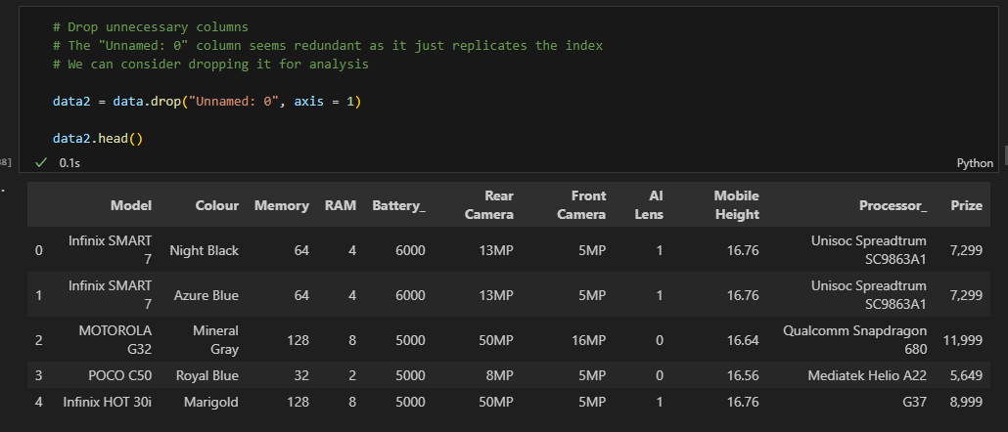
Data Pre processing
Handled missing values, outliers and inconsistencies in the dataset. Converted categorical variables into a suitable numerical format, using One-hot encoding, Ordinal encoding and Label Encoding

Slide 12
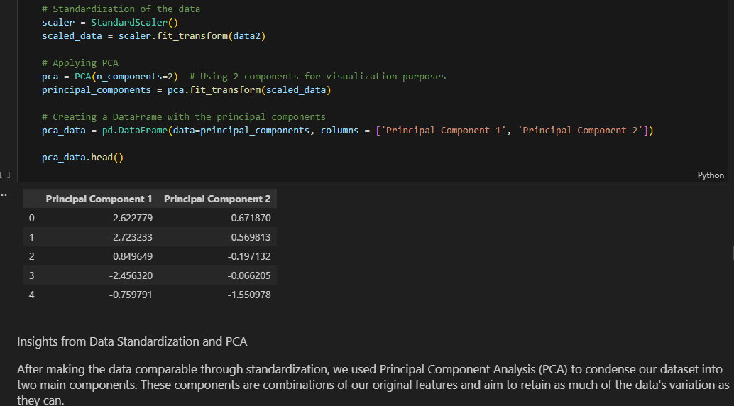
Feature Extraction

Slide 13
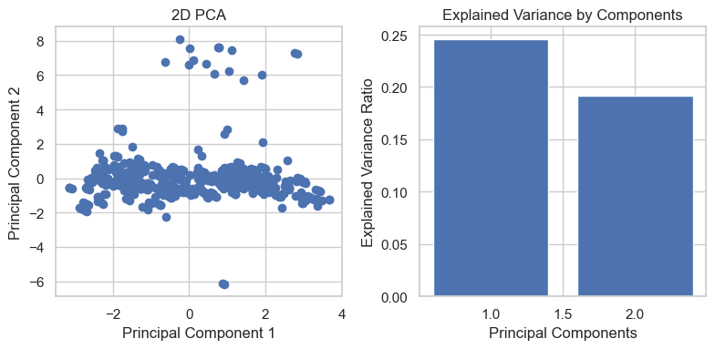
Visualizing these components and Exploring the explained variance ratio

Slide 14
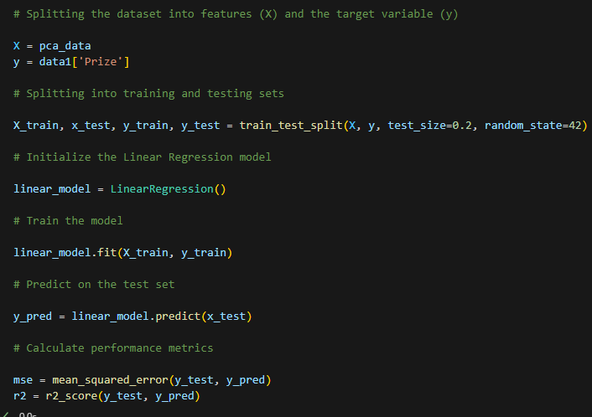
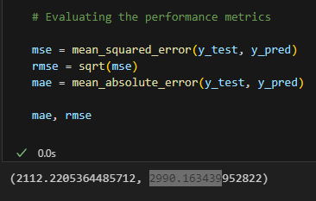

Model Building and Evaluation

Slide 15
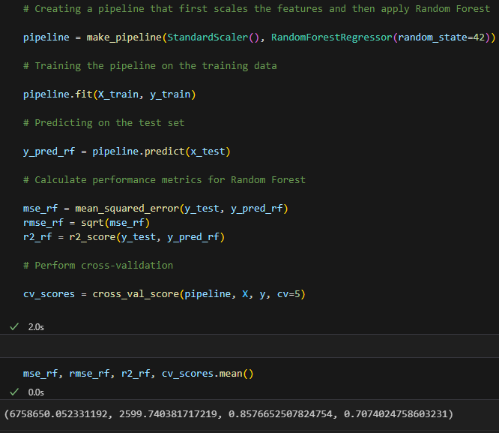
Linear Regression
Random Forest Tree

Slide 16
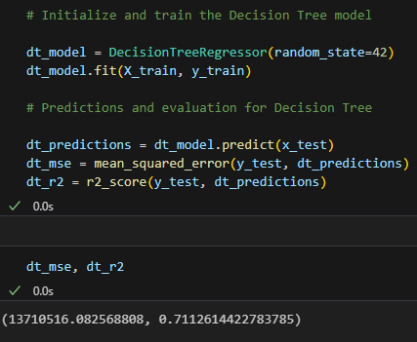
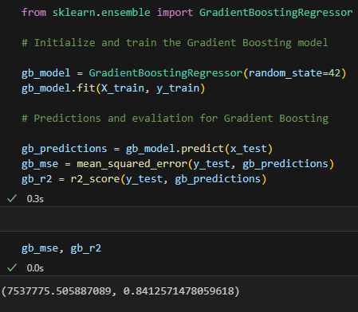
Decision tree and Gradient Boosting
Decision Tree Gradient Boosting

Slide 17
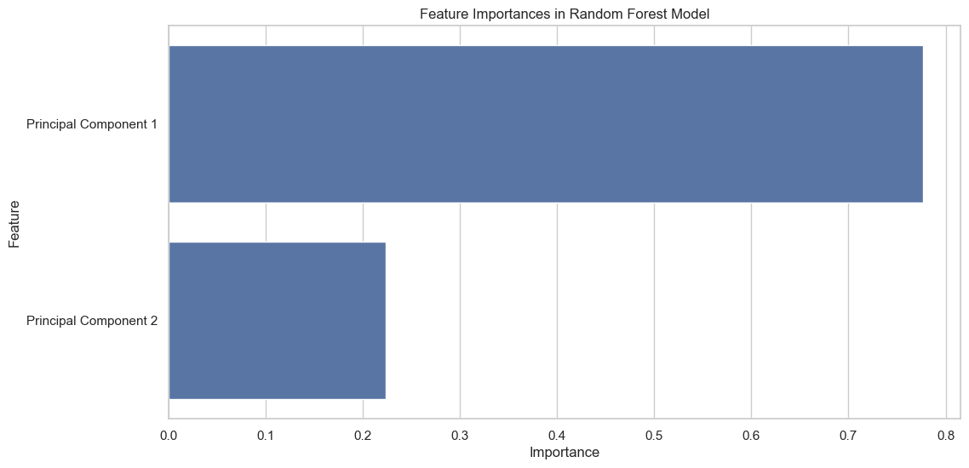
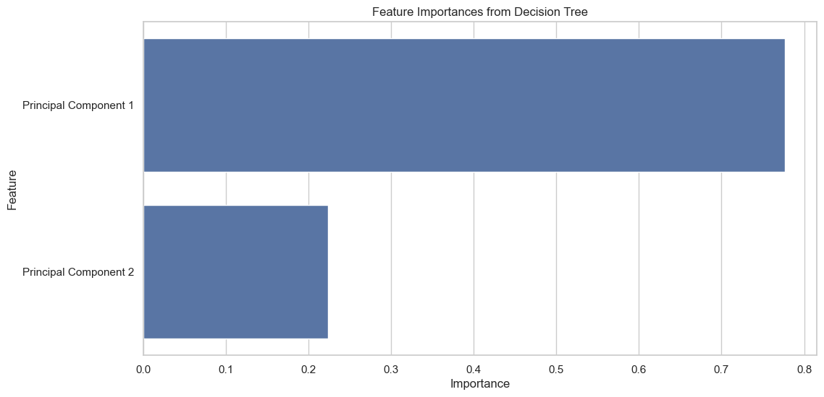
Feature Importance Analysis
Random Forest model Decision Tree

Slide 18
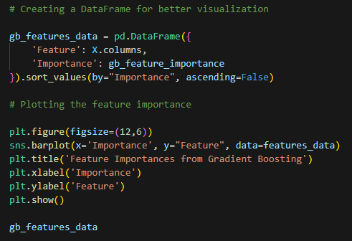

Gradient boosting

Slide 19
Recommendations
Focus on boosting memory in premium phone models, especially for customers who care about performance. Let them know about this in your marketing.
Understand that different groups of people want different things from their phones. For example, gamers might care more about how fast the processor is and how much RAM there is, while travellers might care more about battery life and durability.
Keep an eye on what your competitors are doing. See how they're promoting their products based on these key features. This can help you understand what's popular in the market and what customers expect.
Talk to your customers directly to find out what they think. Ask them which features are most important to them and how they feel about your products compared to others. This feedback can be really valuable for improving your offerings.

Slide 20
Conclusion
When we use Principal Component Analysis (PCA) to understand data, the first few components capture the most important information. In this case, PC1 is the most important, showing that it holds a lot of the key details for predicting mobile phone prices. PC2 is also important but not as much as PC1.
When we look at memory size (RAM and storage) in phones, we see that having more memory and storage tends to make a phone more expensive. This is good news for people who care about performance because it means they're getting their money's worth when they buy phones with more memory and storage.

